Slide 1
Data Preparation
Pentaho
User Manual

Slide 2
IPUT
FILT
RAIN
JOIN
OPUT
Data Preparation Brief Steps
05
04
03
OPUT
02
JOIN
01
RAIN
Text File Output
FILT
Multiple Way Merge Join
IPUT
Rain input
Filter Data
TEXT File Input
Notes:
© Copyright PresentationGo.com – The free PowerPoint template library

Slide 3
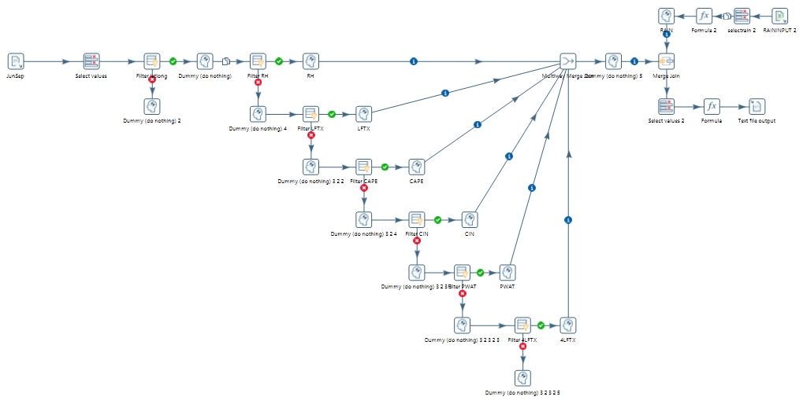
IPUT
FILT
RAIN
JOIN
OPUT
Data Preparation (1)

Slide 4
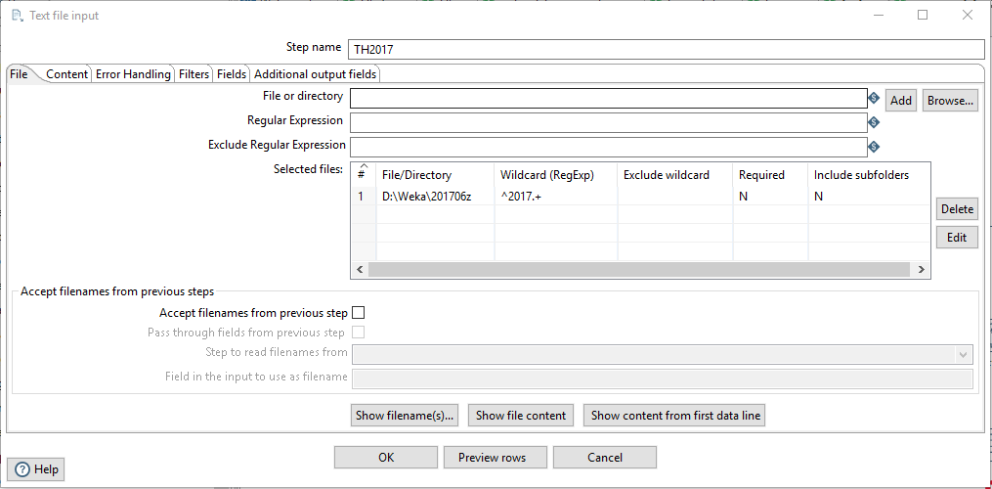
IPUT
FILT
RAIN
JOIN
OPUT
Data Preparation (2)
Text file input
✓
✓
✓
✓

Slide 5
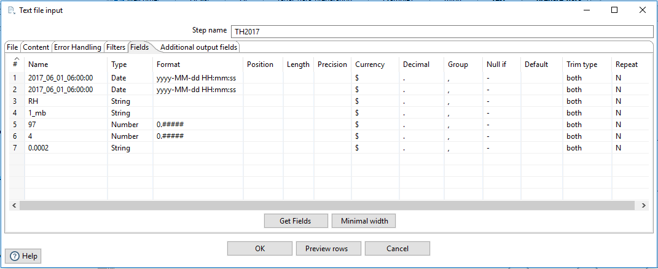
IPUT
FILT
RAIN
JOIN
OPUT
Data Preparation (3)
✓

Slide 6
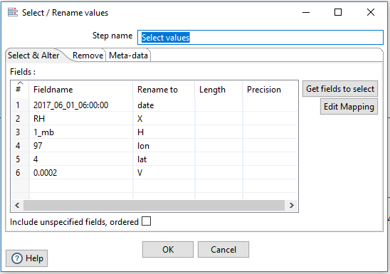
IPUT
FILT
RAIN
JOIN
OPUT
Data Preparation (4)
✓

Slide 7
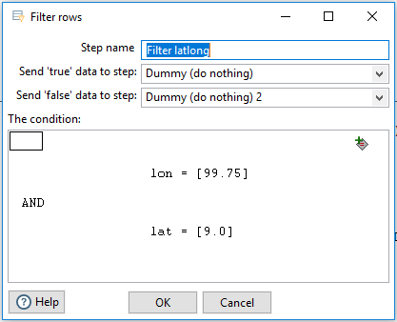
IPUT
FILT
RAIN
JOIN
OPUT
Data Preparation (5)

Slide 8
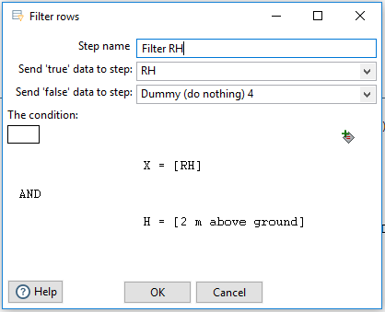
IPUT
FILT
RAIN
JOIN
OPUT
Data Preparation (6)

Slide 9
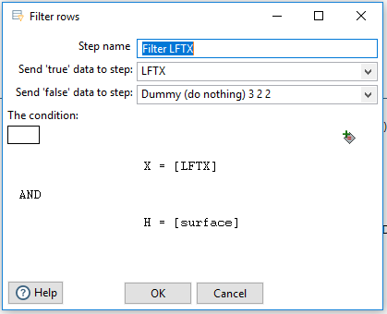
IPUT
FILT
RAIN
JOIN
OPUT
Data Preparation (7)

Slide 10
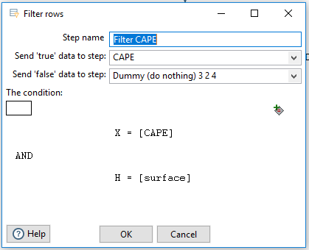
IPUT
FILT
RAIN
JOIN
OPUT
Data Preparation (8)

Slide 11
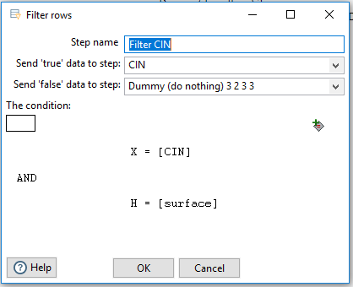
IPUT
FILT
RAIN
JOIN
OPUT
Data Preparation (9)

Slide 12
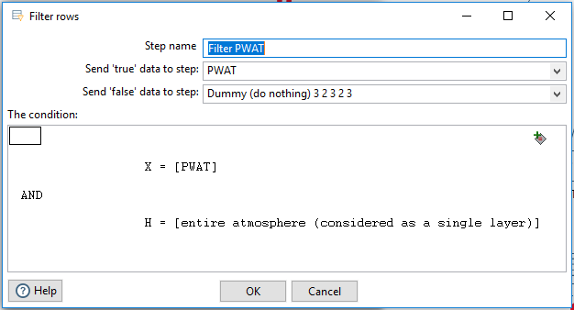
IPUT
FILT
RAIN
JOIN
OPUT
Data Preparation (10)

Slide 13
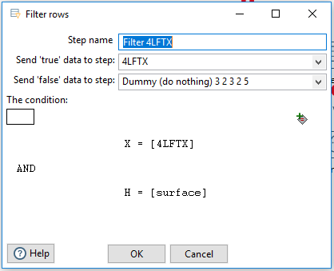
IPUT
FILT
RAIN
JOIN
OPUT
Data Preparation (11)

Slide 14
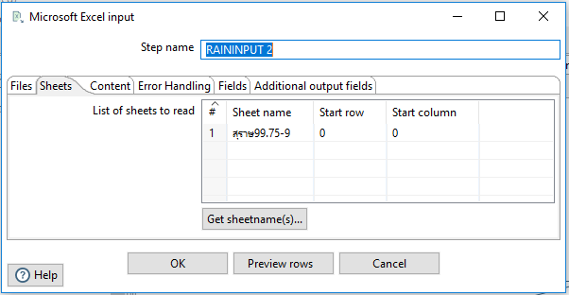
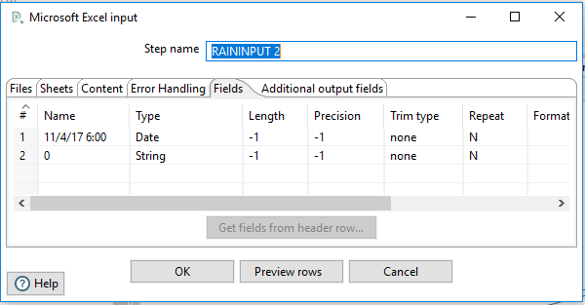
IPUT
FILT
RAIN
JOIN
OPUT
Data Preparation (12)
✓
✓
✓
✓
✓
✓

Slide 15
IPUT
FILT
RAIN
JOIN
OPUT
Data Preparation (13)
✓
✓

Slide 16
IPUT
FILT
RAIN
JOIN
OPUT
Data Preparation (14)
✓
✓

Slide 17
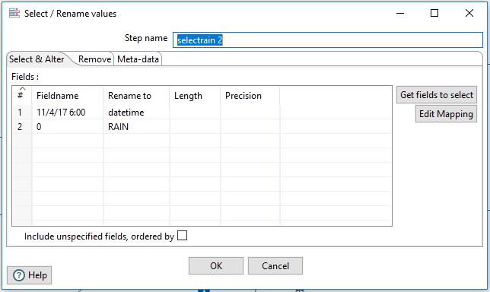
IPUT
FILT
RAIN
JOIN
OPUT
Data Preparation (15)
✓

Slide 18
IPUT
FILT
RAIN
JOIN
OPUT
Data Preparation (16)
if([rain]="-";0;[rain])

Slide 19
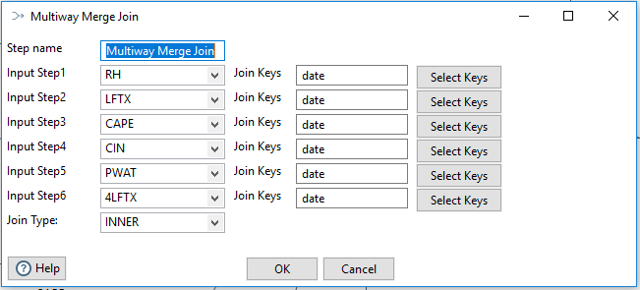
IPUT
FILT
RAIN
JOIN
OPUT
Data Preparation (17)
Multiway merge join

Slide 20
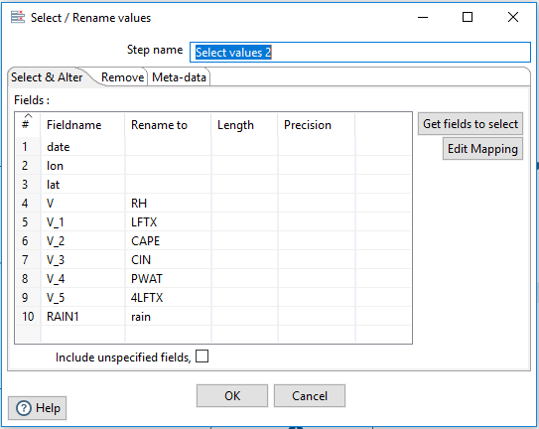
IPUT
FILT
RAIN
JOIN
OPUT
Data Preparation (18)

Slide 21
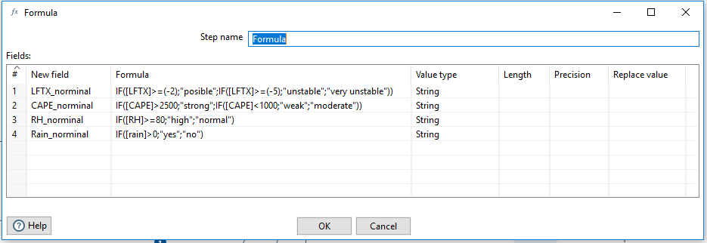
IPUT
FILT
RAIN
JOIN
OPUT
Data Preparation (19)
IF([LFTX]>=(-2);"posible";IF([LFTX]>=(-5);"unstable";"very unstable"))
IF([CAPE]>2500;"strong";IF([CAPE]<1000;"weak";"moderate"))
IF([RH]>=80;"high";"normal")
IF([rain]>0;"yes";"no")

Slide 22
IPUT
FILT
RAIN
JOIN
OPUT
Data Preparation (20)
Text file output

Slide 23
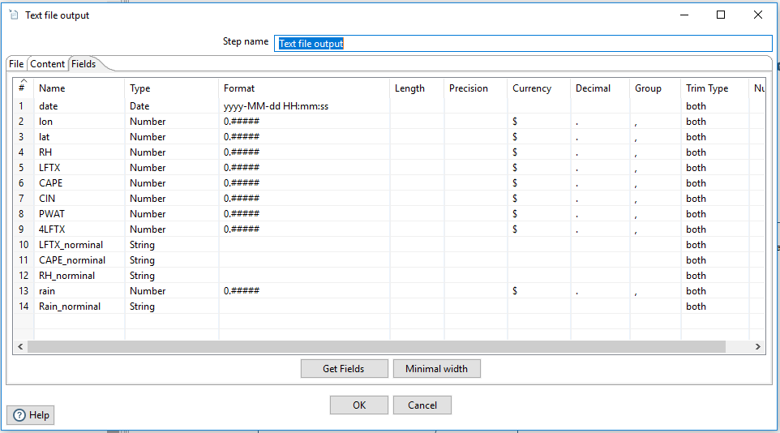
IPUT
FILT
RAIN
JOIN
OPUT
Data Preparation (21)

Slide 24
Thank You
for
Reading

