Slide 1



Heat Index
Pentaho
User Manual

Slide 2



LOAD
SET
CON
INP
GET
Heat Index Brief Steps
Set lat, lon, date, time, and variables (temperature and relative humidity)
2
Input the variable data in csv format into Pentaho program
4
Display Heat Index forecast data using Surfer program
6
LOAD
SET
CON
INP
GET
1
Download GFS
grib2-format data using grib-filter tool
3
Convert data from grib2 format to csv format
5
Apply Heat Index formula to get Heat Index forecast
Notes:
© Copyright PresentationGo.com – The free PowerPoint template library

Slide 3


LOAD
SET
CON
INP
GET
Heat Index (1)
Copy all dll files and wgrib.exe, paste on new folder names “NCEPdata”
Install wgrib2.exe
Copy Data Integration folder
Copy JAVA
Install JAVA

Slide 4
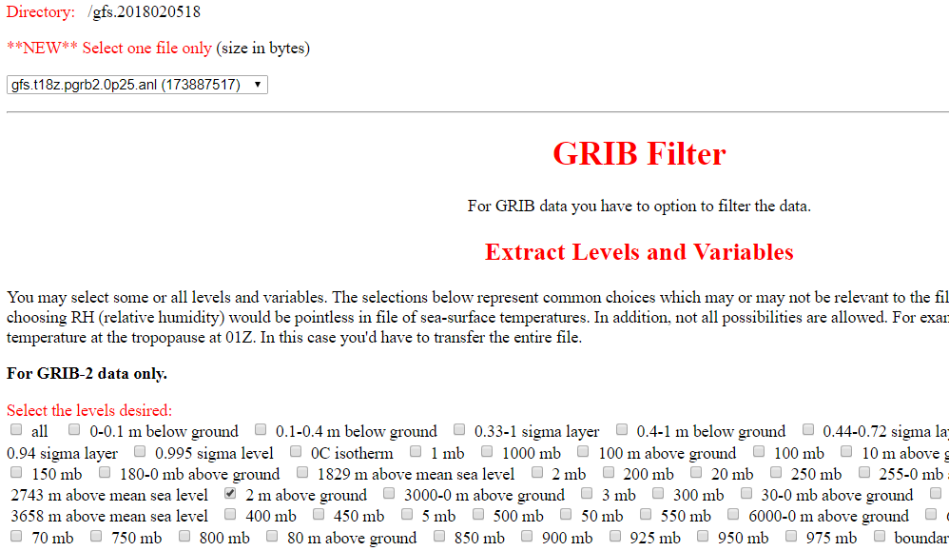
LOAD
SET
CON
INP
GET
Heat Index (2)
Download NCEP data @ http://nomads.ncep.noaa.gov/cgi-bin/filter_gfs_0p25_1hr.pl

Slide 5
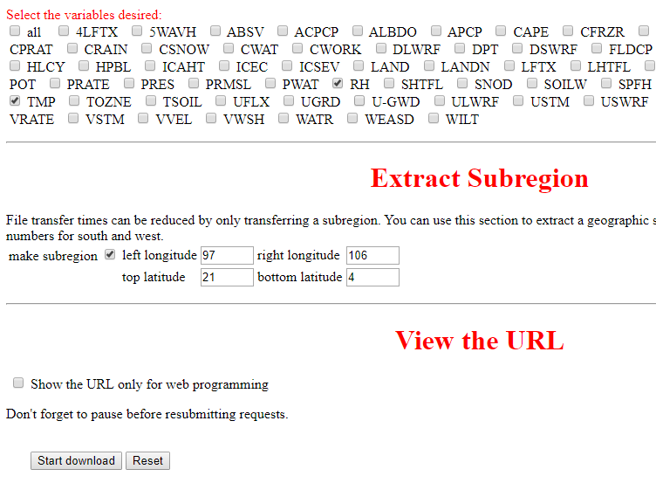
LOAD
SET
CON
INP
GET
Heat Index (3)

Slide 6
LOAD
SET
CON
INP
GET
Heat Index (4)
Step following
Save gfs file in wgrib2 folder
Open command page
cd <NCEPdata folder>
3. Get into data-integration folder
4. Open spoon.bat

Slide 7
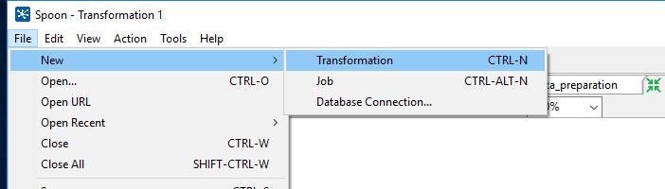
LOAD
SET
CON
INP
GET
Heat Index (5)
Make new transformation

Slide 8
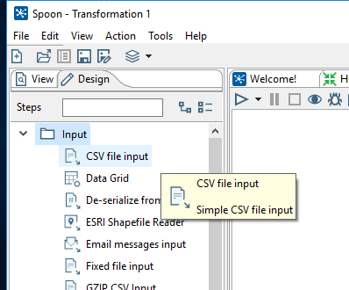
LOAD
SET
CON
INP
GET
Heat Index (6)
CSV file input

Slide 9
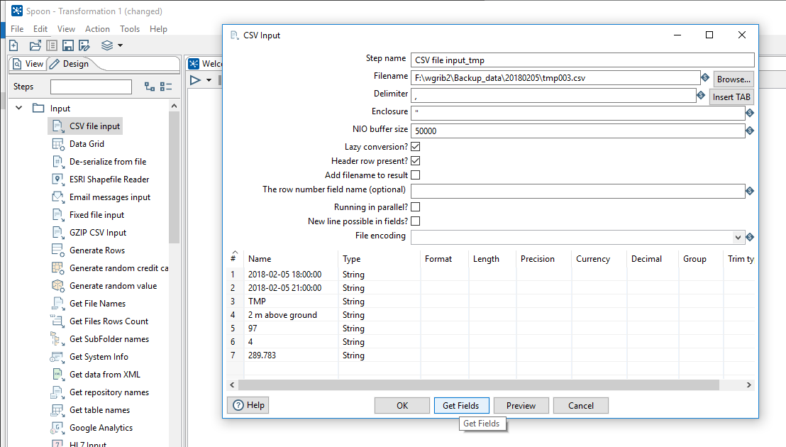
LOAD
SET
CON
INP
GET
Heat Index (7)
Csv file input-TMP
✓
✓
✓

Slide 10
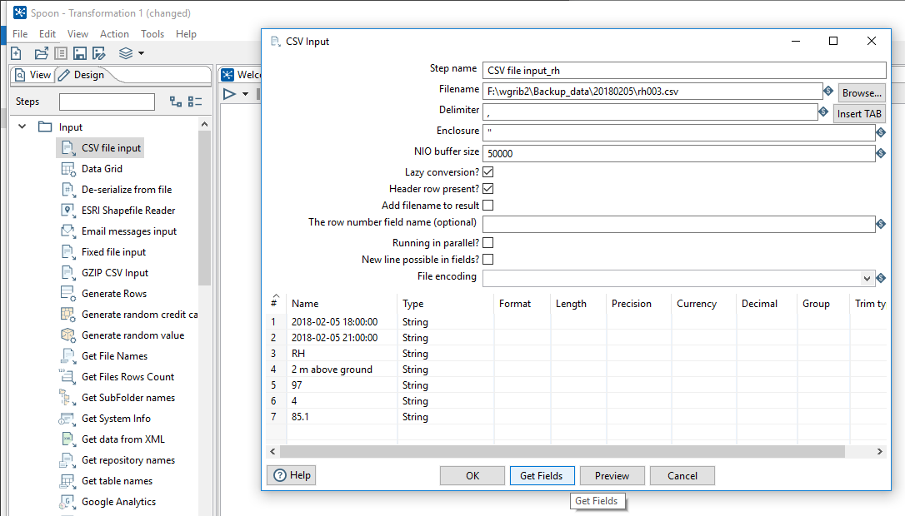
LOAD
SET
CON
INP
GET
Heat Index (8)
Csv file input-RH
✓
✓
✓

Slide 11
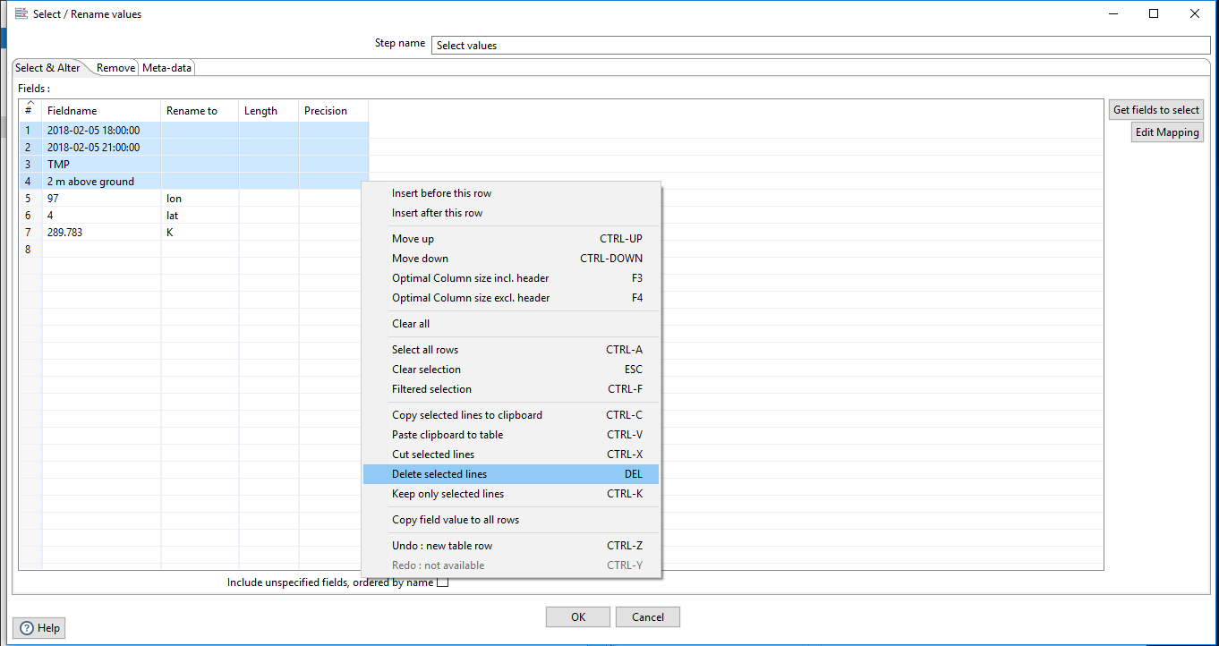
LOAD
SET
CON
INP
GET
Heat Index (9)
Select value-TMP
✓
✓
✓

Slide 12
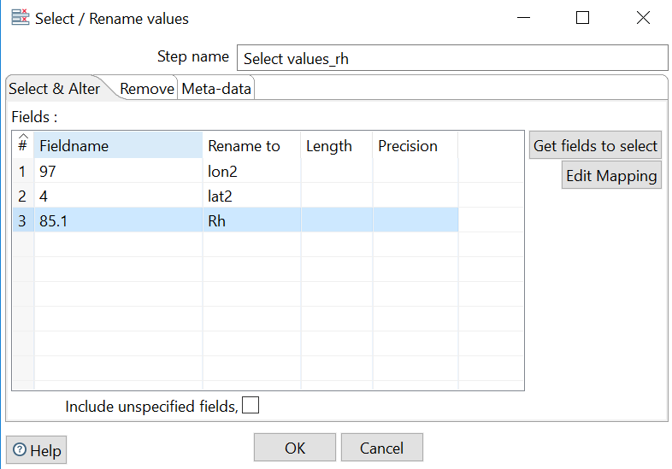
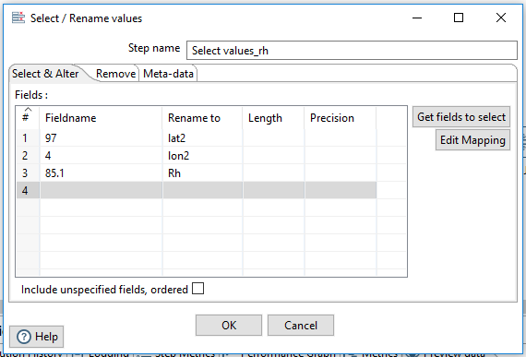
LOAD
SET
CON
INP
GET
Heat Index (10)
Select value-RH
✓
✓

Slide 13
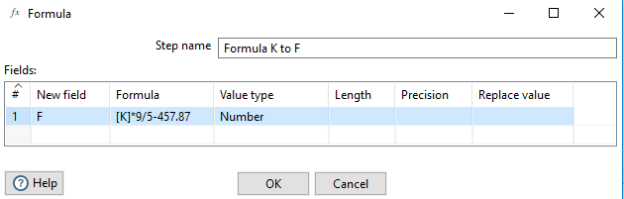
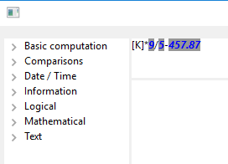
LOAD
SET
CON
INP
GET
Heat Index (11)
Convert K to F; [K]*9/5-457.87

Slide 14
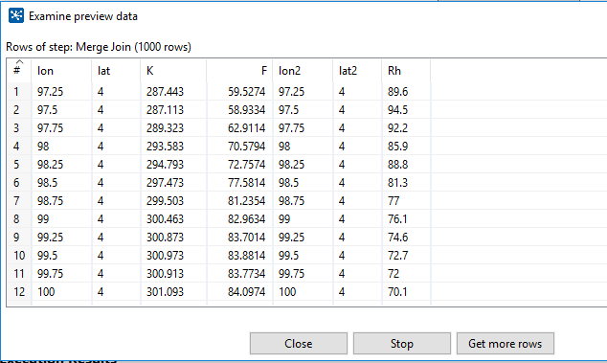
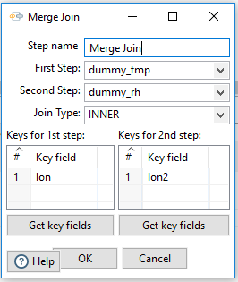
LOAD
SET
CON
INP
GET
Heat Index (12)
Merge Join

Slide 15
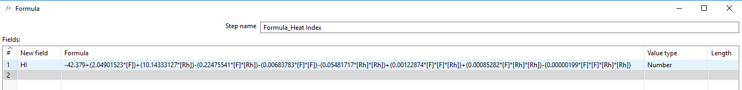
LOAD
SET
CON
INP
GET
Heat Index (13)
Calculate HI;
-42.379+(2.04901523*[F])+(10.14333127*[Rh])-(0.22475541*[F]*[Rh])-(0.00683783*[F]*[F])-(0.05481717*[Rh]*[Rh])+(0.00122874*[F]*[F]*[Rh])+(0.00085282*[F]*[Rh]*[Rh])-(0.00000199*[F]*[F]*[Rh]*[Rh])

Slide 16
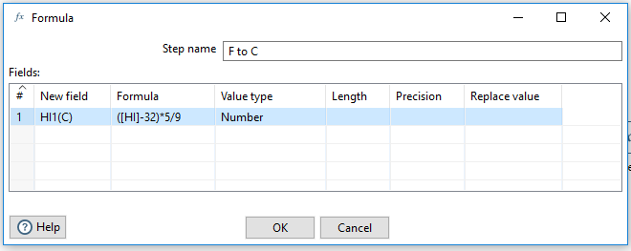
LOAD
SET
CON
INP
GET
Heat Index (14)
Convert F to C; ([HI]-32)*5/9

Slide 17
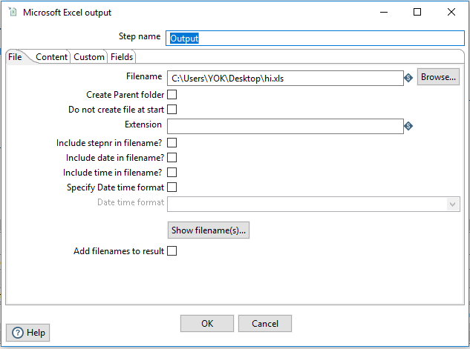
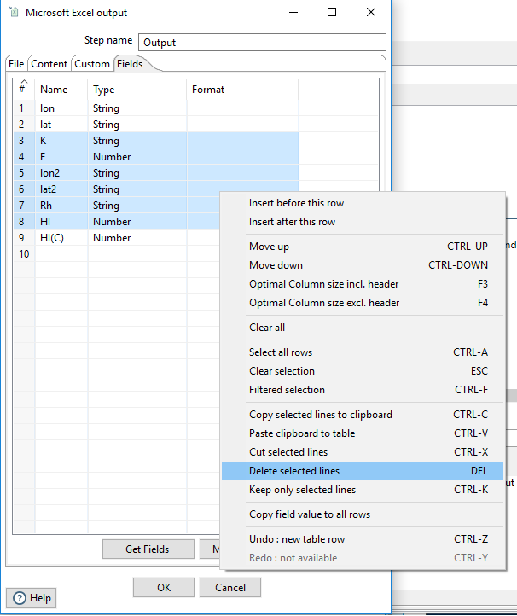
LOAD
SET
CON
INP
GET
Heat Index (15)
MS Excel output
✓
✓

Slide 18
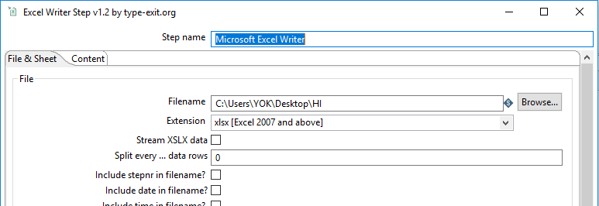
LOAD
SET
CON
INP
GET
Heat Index (16)
MS Excel writer
✓
✓

Slide 19

Thank You
for
Reading

