Slide 1
Model Development
Weka
User Manual

Slide 2
CSV
ARFF
MLR
DCT
ANN
Model Development
05
04
03
ANN
02
DCT
01
MLR
Artificial Neural Network
(ANN) Model
ARFF
Decision Tree Model
CSV
Multilinear Regression Model
Convert .csv to .arff
Use Data from .csv file
Notes:
© Copyright PresentationGo.com – The free PowerPoint template library

Slide 3
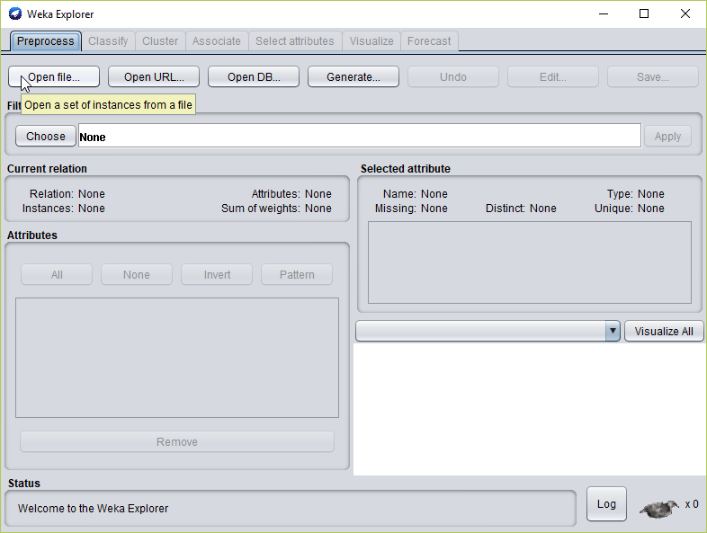
CSV
ARFF
MLR
DCT
ANN
Model Development (1)
เปิดโปรแกรมและ Open files… เลือกไฟล์ .csv

Slide 4
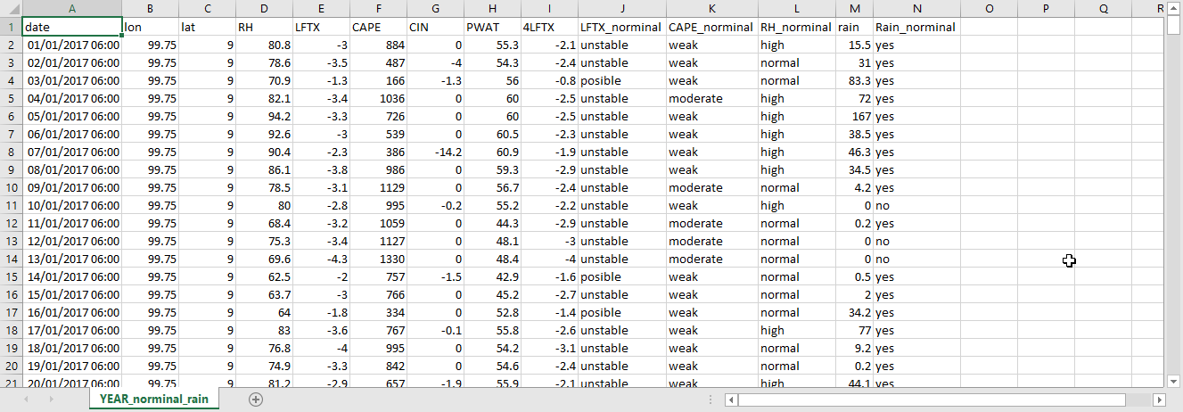
CSV
ARFF
MLR
DCT
ANN
Model Development (2)
Data Input ที่จะใช้ในโปรแกรม

Slide 5
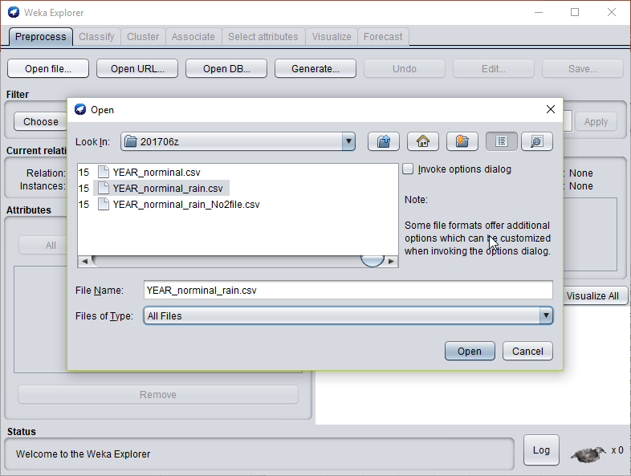
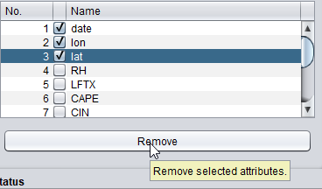
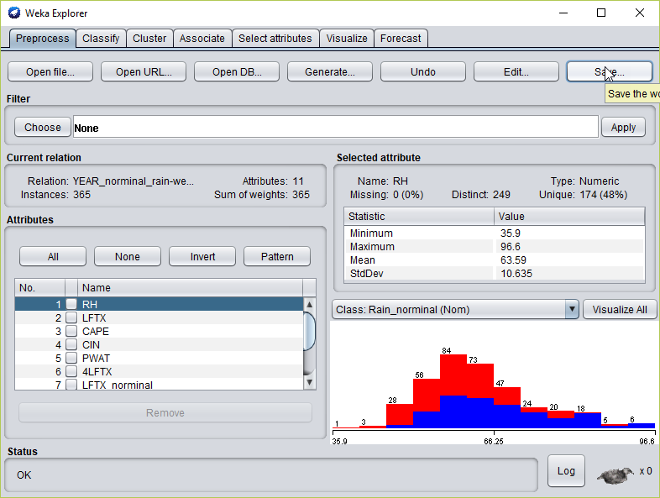
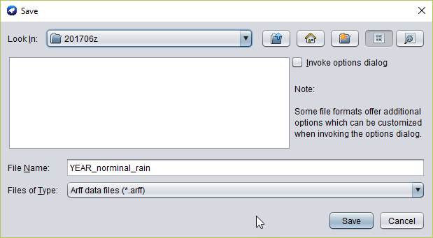
CSV
ARFF
MLR
DCT
ANN
Model Development (3)
Convert .csv to .arff

Slide 6
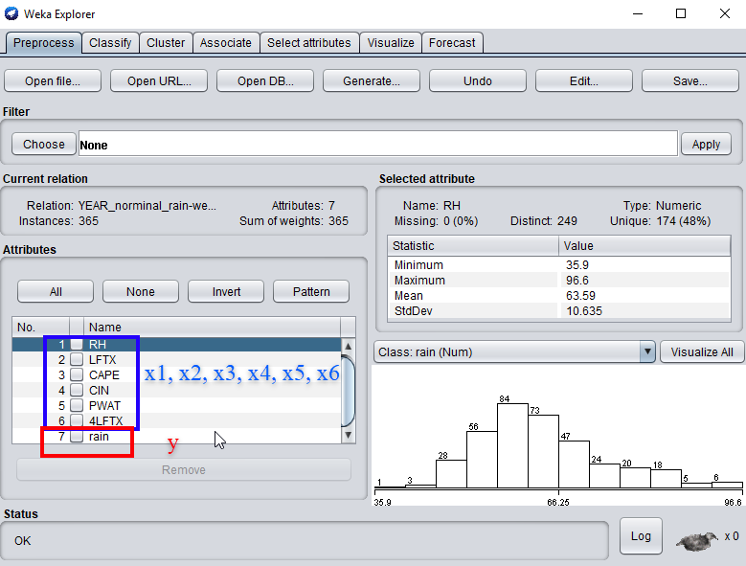
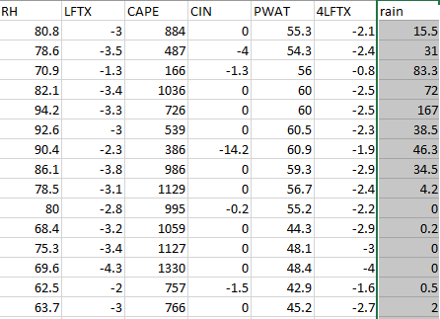
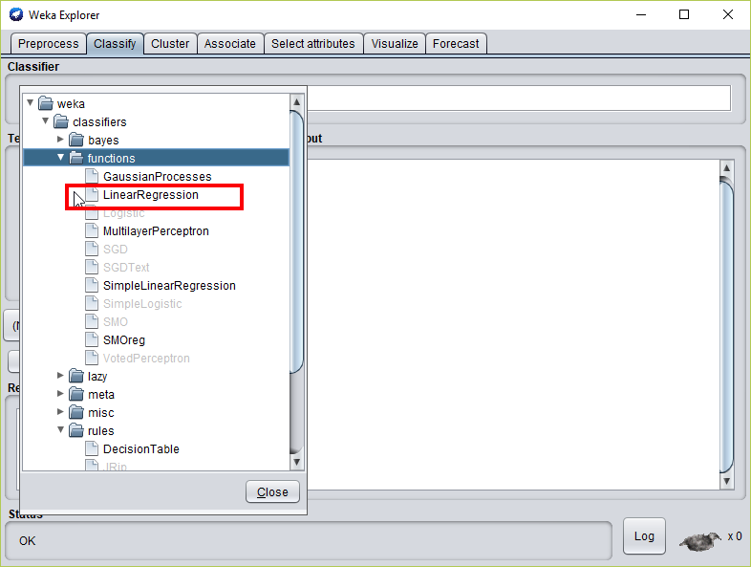
CSV
ARFF
MLR
DCT
ANN
Model Development (4)
Multiple Linear Regression : Set up

Slide 7
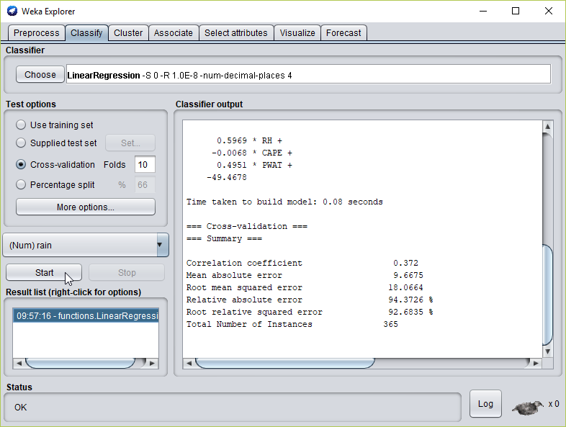
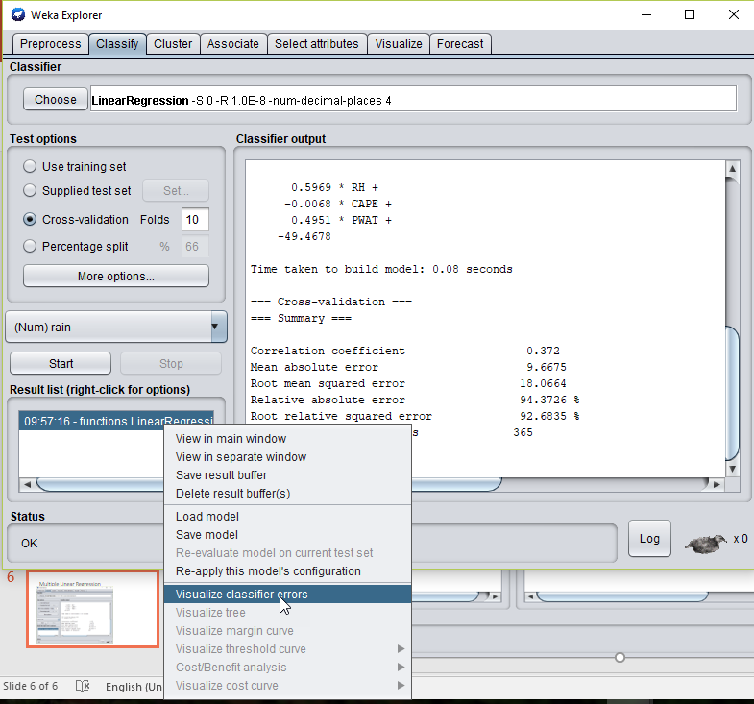
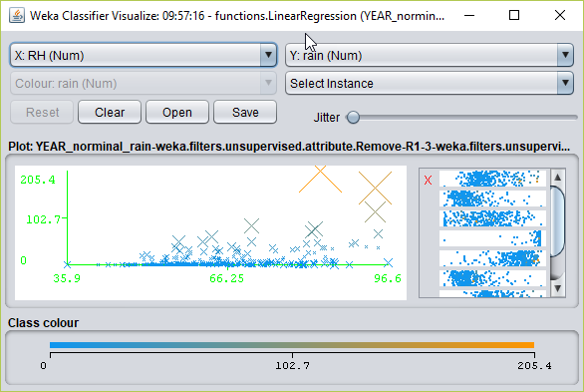
CSV
ARFF
MLR
DCT
ANN
Model Development (5)
Multiple Linear Regression : Create Model

Slide 8
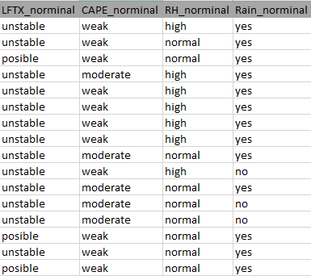
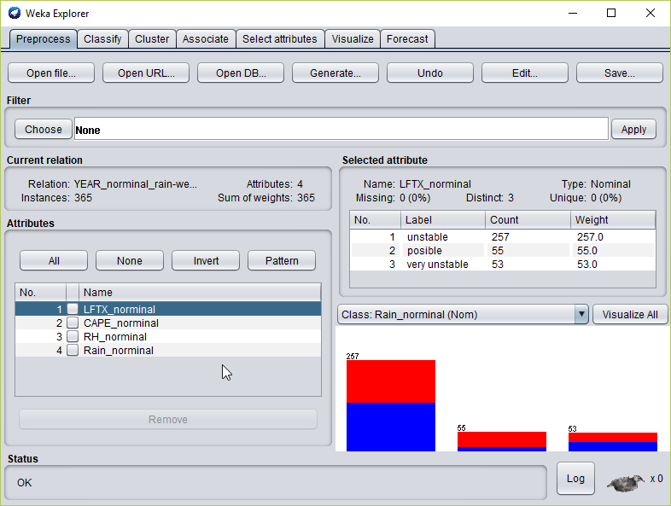
CSV
ARFF
MLR
DCT
ANN
Model Development (6)
Decision Tree : Set up

Slide 9
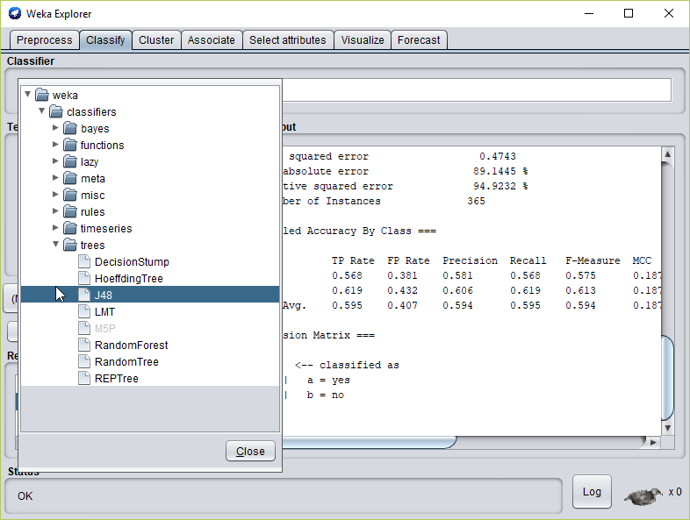
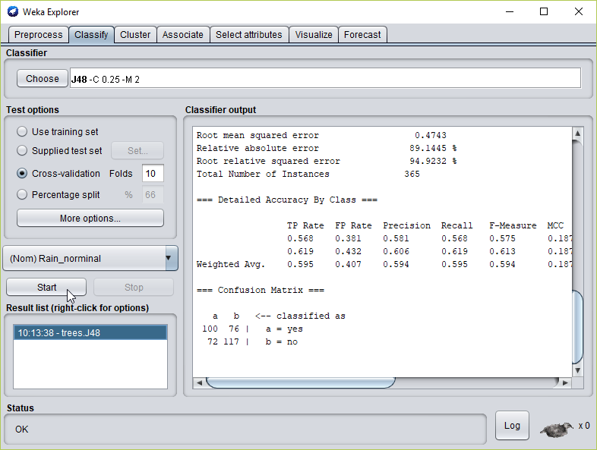
CSV
ARFF
MLR
DCT
ANN
Model Development (7)
Decision Tree : Set up

Slide 10
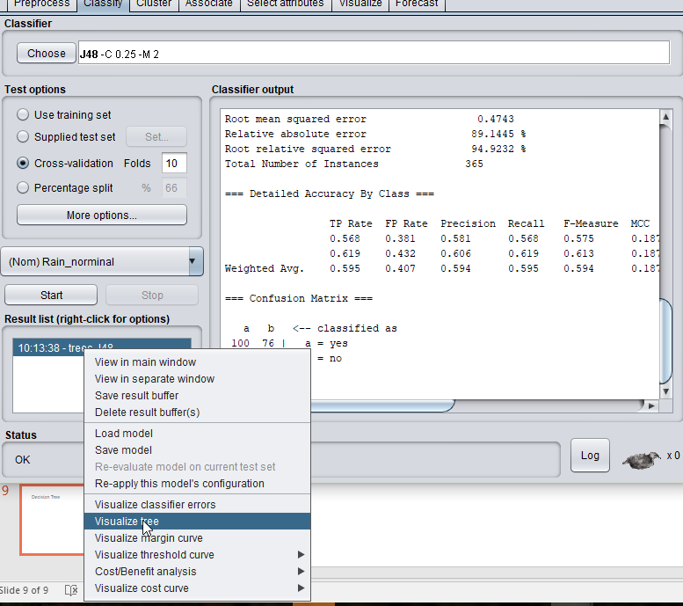
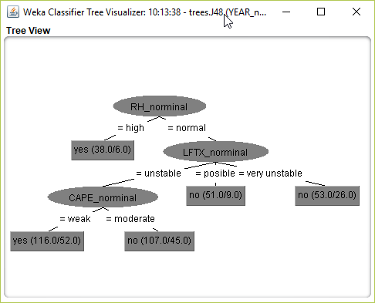
CSV
ARFF
MLR
DCT
ANN
Model Development (8)
Decision Tree : Create Model

Slide 11
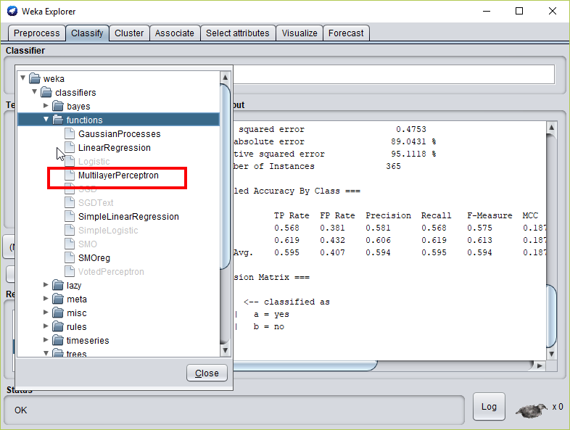
CSV
ARFF
MLR
DCT
ANN
Model Development (9)
Artificial Neural Network (ANN) : Set up

Slide 12
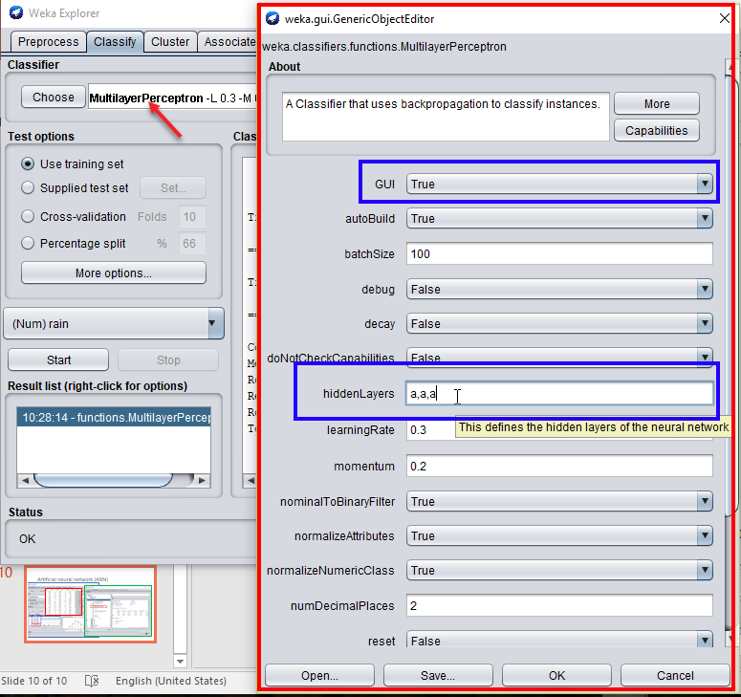
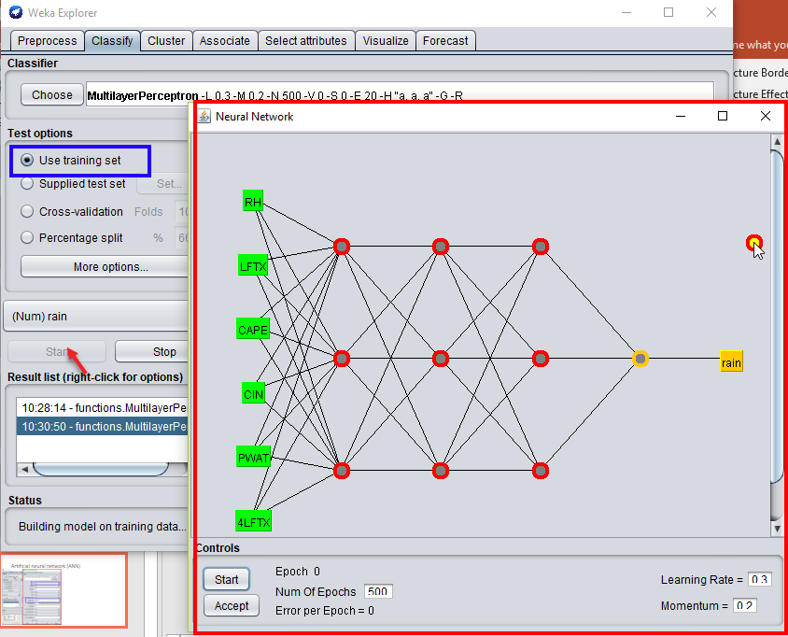
CSV
ARFF
MLR
DCT
ANN
Model Development (10)
Artificial Neural Network (ANN) : Set up

Slide 13
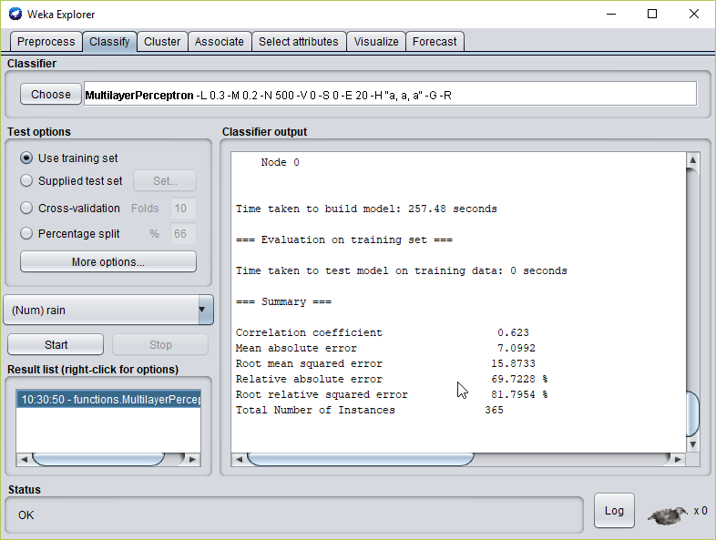
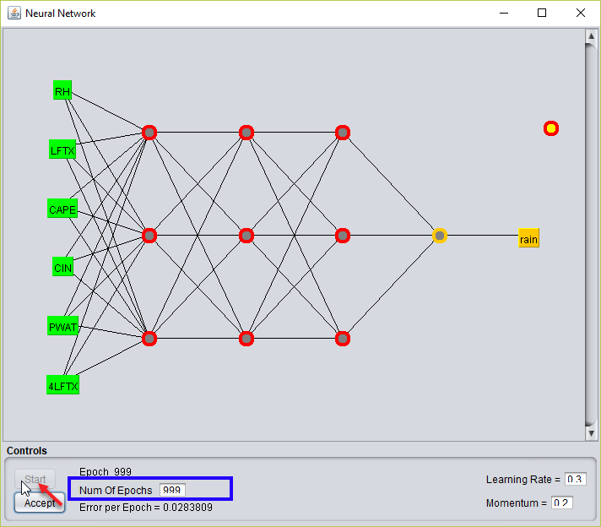
CSV
ARFF
MLR
DCT
ANN
Model Development (11)
Artificial Neural Network (ANN) : Create Model

Slide 14
Thank You
for
Reading

