Slide 1



Surfer
Installation

Slide 2
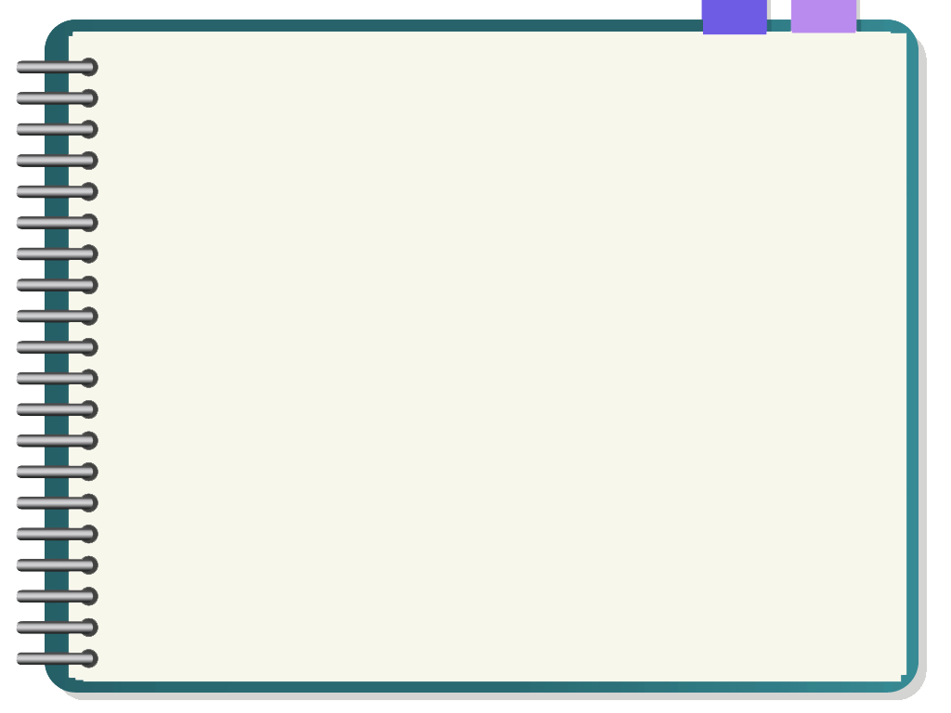

RUN
START
Installation Brief Steps
02
01
START
RUN
Start Surfer Program
Run .exe
for Installation
Notes:
© Copyright PresentationGo.com – The free PowerPoint template library

Slide 3

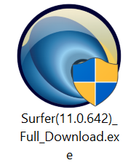

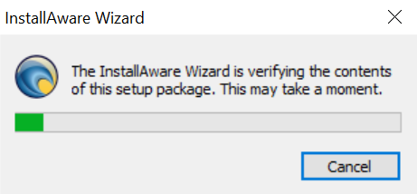
RUN
START
RUN
Installation (1)
กด .exe เพื่อติดตั้ง

Slide 4
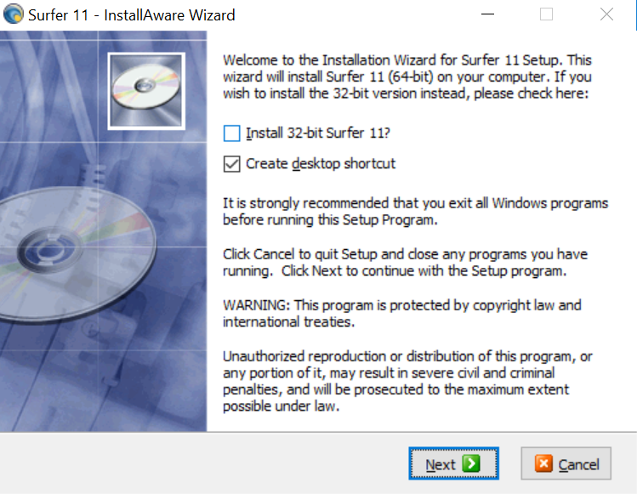
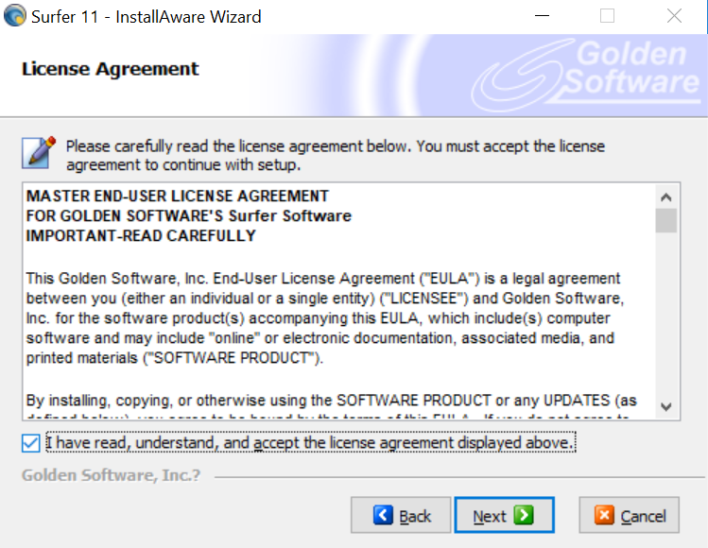
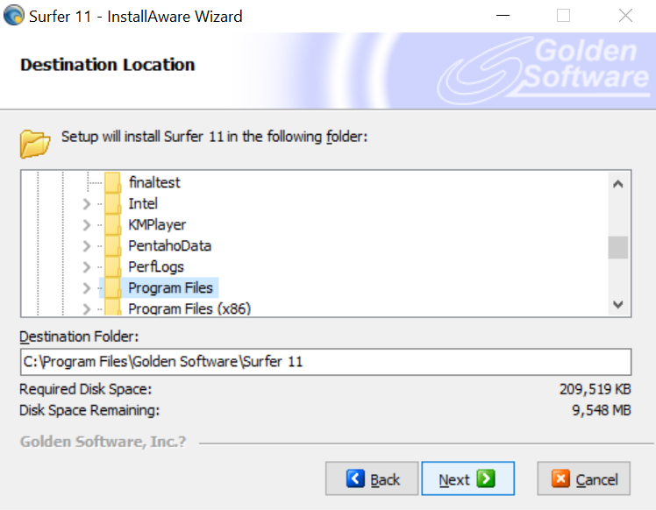
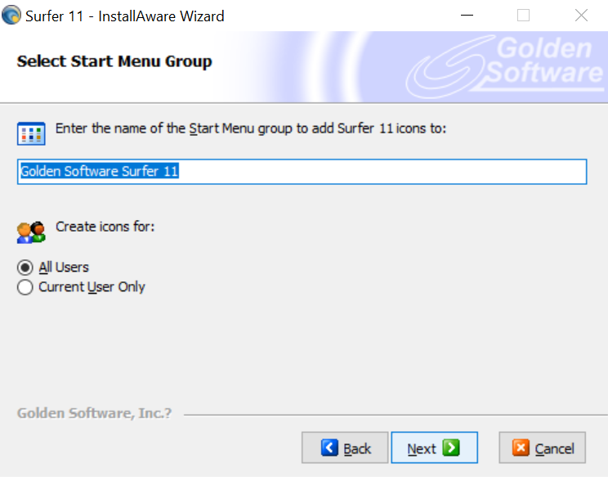
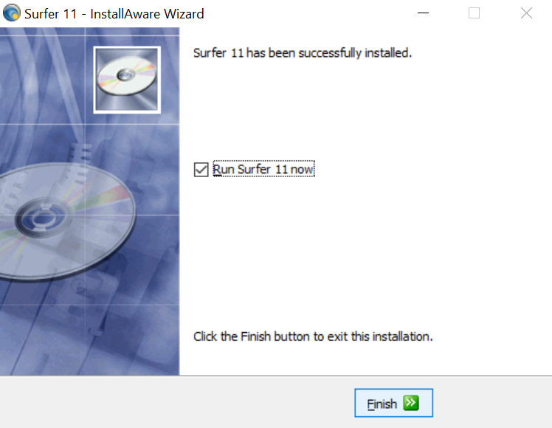
RUN
START
Installation (2)
กด Next และ Finish

Slide 5
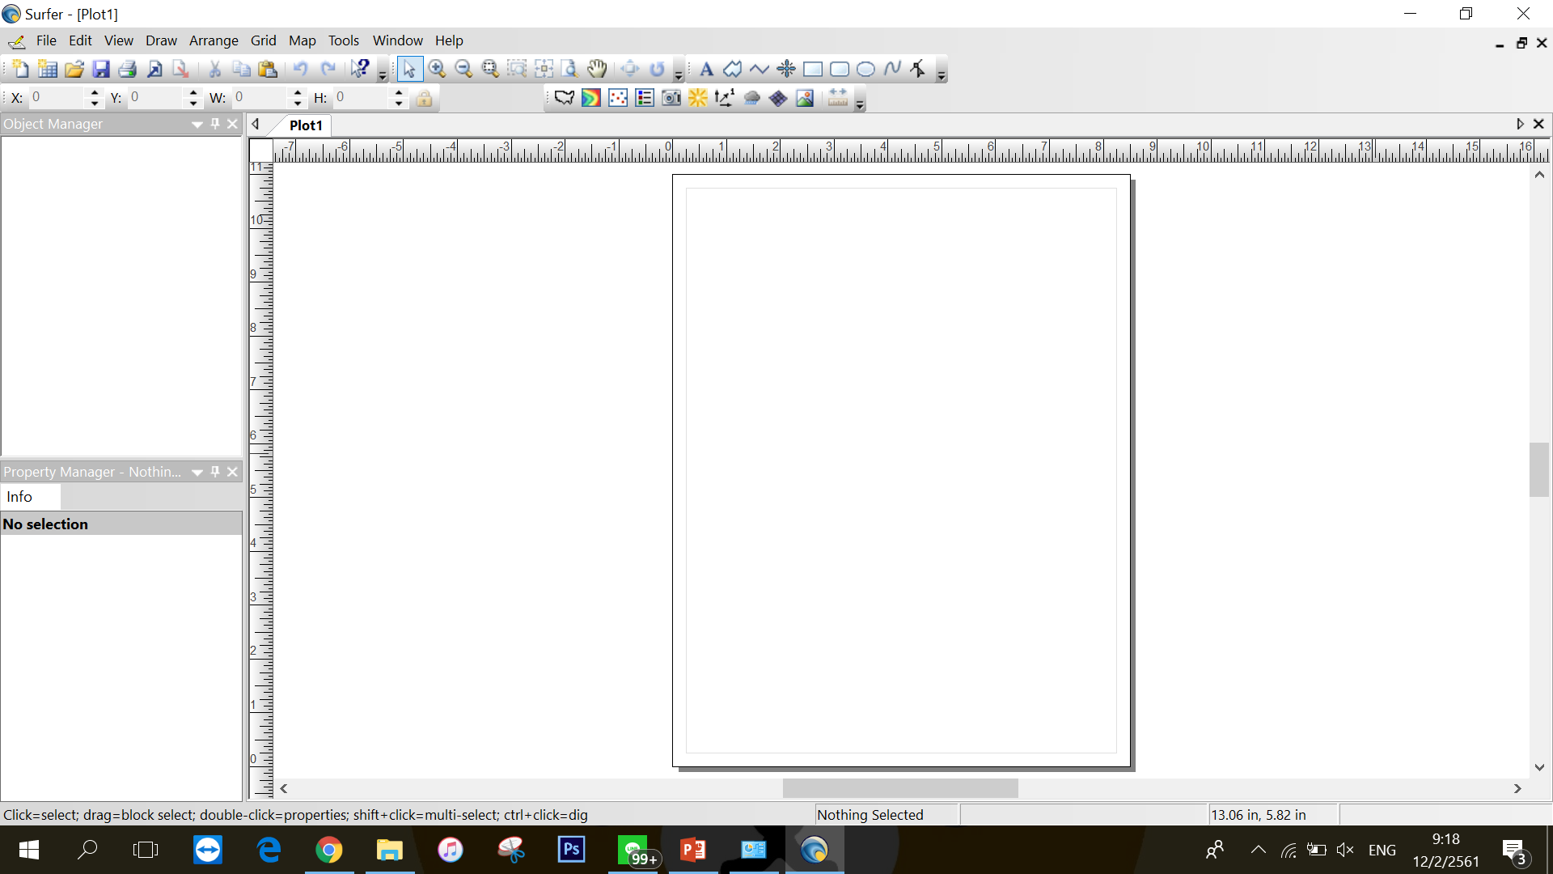
RUN
START
Installation (3)
Start Program Surfer

Slide 6

Thank You
for
Reading

